Slide 1
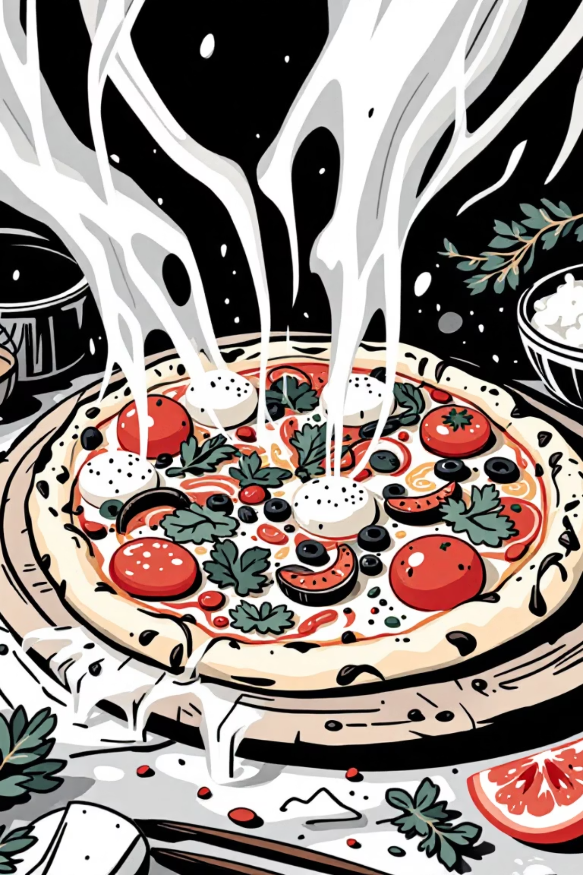
Pizza Sales Analysis: Project Report
Analyzing pizza sales data to extract meaningful business insights and support data-driven decision-making for growth.

Slide 2
Introduction & Problem Statement
Industry Context
The Challenge
The food industry is highly competitive with frequent customer preference changes. Effective sales data analysis is crucial for profitability.
Management lacks clear visibility into pizza sales performance, struggling to identify top/least-selling items, revenue contributions by category/size, and sales trends.
Pizza restaurants generate vast transactional data, but raw data lacks clear insights for management.
Decisions are often assumption-based. A structured analysis and dashboard are needed.

Slide 3

Project Objectives
1
2
Revenue & Orders
Product Performance
Calculate total revenue, total orders, and total pizzas sold.
Identify best/least-selling pizza categories and analyze sales by size.
3
Sales Trends
Understand daily and monthly sales trends, identifying peak periods.

Slide 4

Scope & Dataset
Dataset Description
Transactional pizza sales records including Order Date, Pizza Category, Pizza Size, Quantity Sold, and Total Price. Data is structured for analytical processing.
Project Scope
Limited to historical pizza sales data, focusing on sales-related attributes like order date, category, size, quantity, and price. Customer demographics are excluded.
Focuses on descriptive analysis and visualization; predictive modeling is outside scope.

Slide 5


Methodology & Tools
Data collection
Data cleaning
Data extraction
KPI calculation
Dashboard creation
Our methodology ensures accurate and meaningful analysis, transforming raw data into actionable insights.
SQL
Microsoft Excel
Power BI
Data extraction, filtering, and aggregation.
Data cleaning and validation.
Interactive dashboard creation and visualization.

Slide 6
Key Performance Indicators (KPIs)
Total Revenue
Total Orders
Pizzas Sold
Revenue by Category/Size
Daily/Monthly Trends
These KPIs are crucial for evaluating overall business performance and guiding strategic decisions.

Slide 7
Overall Sales Performance
817.86K
38.31
49574
21350
Total Revenue
Avg Order Value
Total Pizzas Sold
Total Orders
2.32
Avg Pizzas per Order
A snapshot of key metrics from January to December 2015, highlighting overall business health.

Slide 8
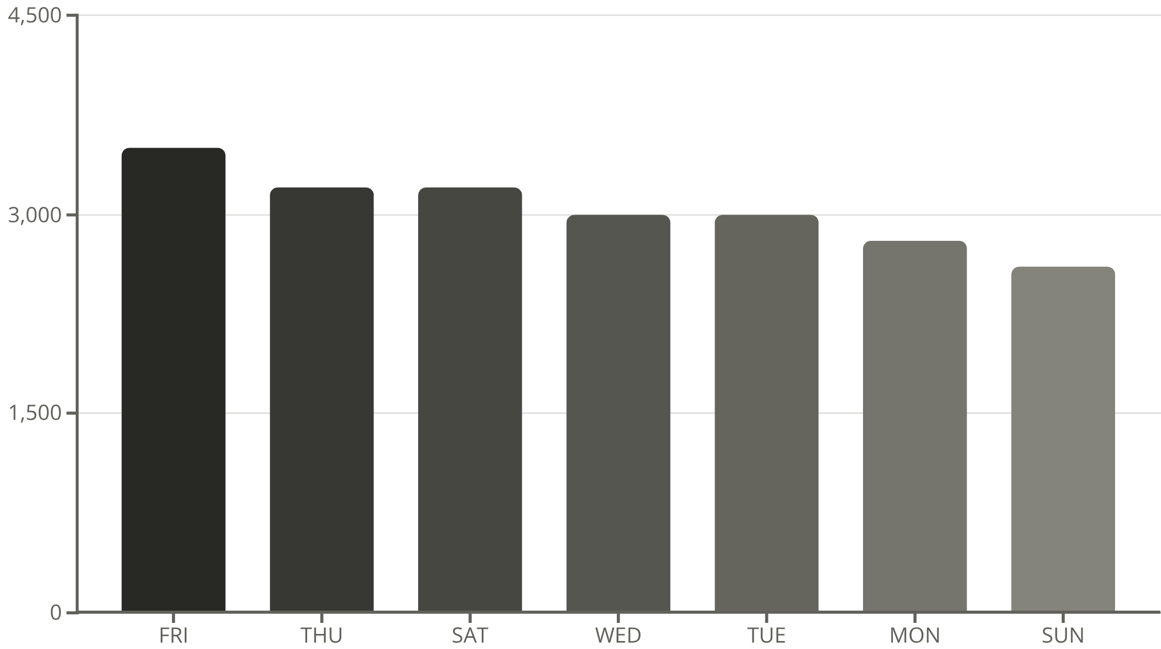
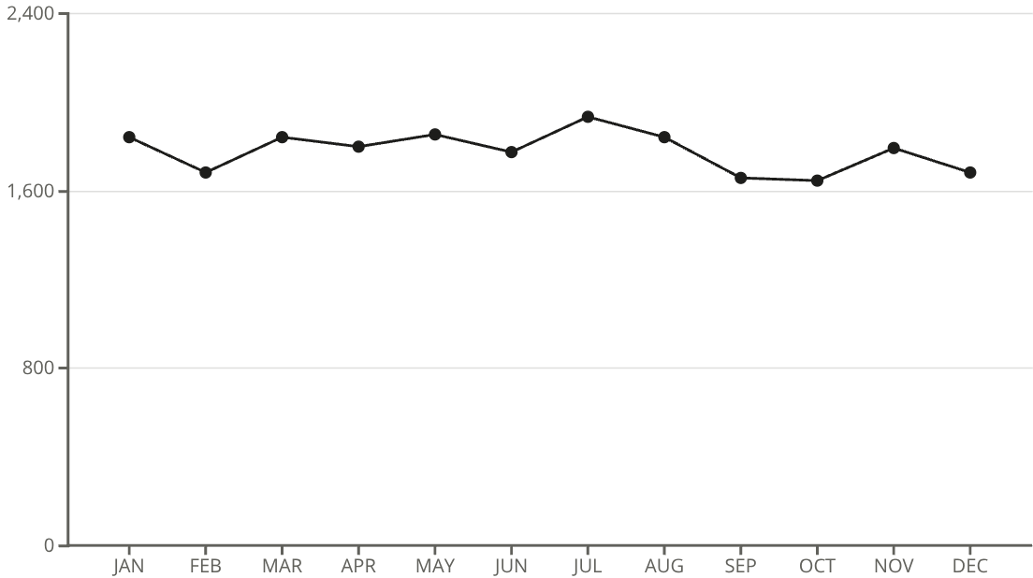
Sales Trends & Peak Periods
July and January show the maximum number of orders, indicating seasonal peaks.
Orders are highest on weekends, particularly Friday and Saturday evenings.

Slide 9


Category & Size Performance
Large
Medium
Regular
X-Large
XX-Large
Large size pizzas contribute to maximum sales, indicating customer preference.
Classic
Supreme
Chicken
Veggie
The Classic category contributes to maximum sales and total orders.

Slide 10

Business Impact & Conclusion
Improved Decision-Making
Efficient Operations
Increased Profitability
Enhanced accuracy in business decisions, moving from assumptions to data-driven strategies.
Better inventory planning and marketing strategies aligned with high-demand periods.
Overall enhancement of operational efficiency and profitability.
This project successfully transforms raw pizza sales data into actionable insights, demonstrating the critical role of data analytics in modern business for effective monitoring and strategic planning.

